Slide 1


Introducing Power BI
Kyle Akepanidtaworn
Global Cloud Solution Architect (Data Platform & AI)
GSMO Digital Transformation Partnerships Team
koakepan@microsoft.com

Slide 2
Meet me
Kyle Akepanidtaworn
Global Cloud Solution Architect, Microsoft
35+ professional certifications across Microsoft, IBM, Tableau, INSEAD
Coach for Knowledge Mining and Azure Cognitive Search
Coach for Modern Data Warehousing on Azure
Azure for SAP Workloads
MCSA: BI Reporting Certified 2020
Microsoft-INSEAD AI Business School
Certified Data Analyst, Data Scientist, Data Engineer, and AI Engineer
Tableau Data Steward, Tableau Data Scientist, Tableau Developer
IBM Data Science Methodologies
Email: koakepan@micrsoft.com
LinkedIn: https://www.linkedin.com/in/korkridakepan/
Kyle Akepanidtaworn, a global cloud solution architect with the mission to helping customers and partners with Digital Transformation, Business Intelligence, Azure, Open Source, and Data Intelligence & Analytics etc. I am a trusted advisor to top Azure customers and help empower them to achieve more.
Specialties: BI + AI, data warehousing, data science, big data, Hadoop, cloud, master data management, machine learning, solution architecture, ETL, data modeling, data migration, dashboarding.

Slide 3
Power BI Overview

Slide 4


Common challenges for BI
Management of BI systems
Time spent on setup and management of BI systems. Ongoing hardware acquisitions and maintenance to meet SLAs
Variety of data sources
Complexity of connecting to on-premise and cloud (SaaS) data sources
Managing data in the cloud
Security, privacy and data refresh concerns for moving data into the cloud
Integration with existing environment
Cost and time involved in integration of solution into existing environment. Extensibility of system
Keeping data current
Complexity of refreshing data from variety of data sources, increased demand for real-time data
Ease of use and adoption
Ease of adoption by business and IT orgs. Time spent on creating reports and visualizations
Notes:
Key message:
There are common challenges that IT professionals are faced with when implementing a new BI solution
Talking points:
Management of BI systems
Variety of data sources
Managing data in the cloud
Integration with existing environment
Keeping data current
Ease of use and adoption

Slide 5

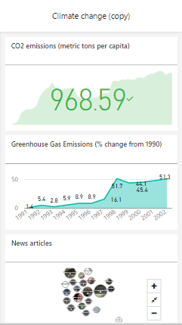
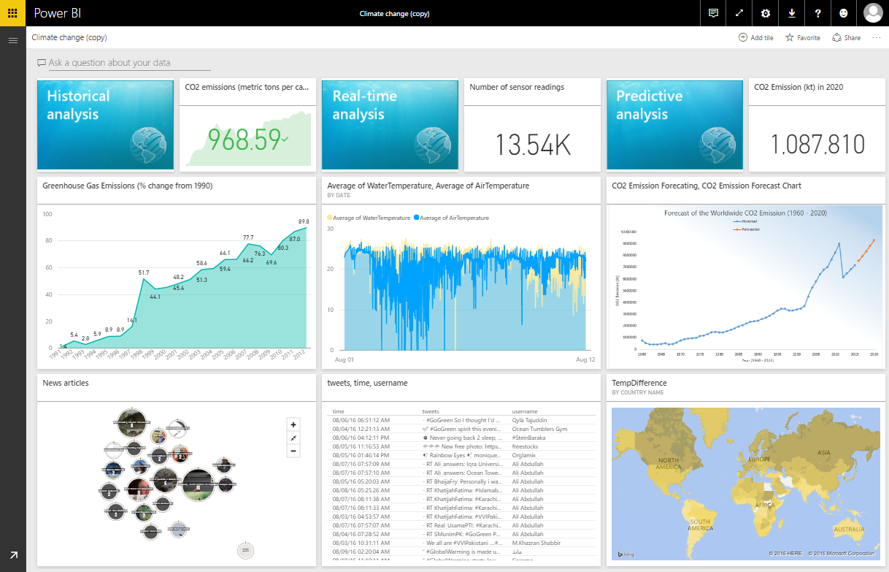

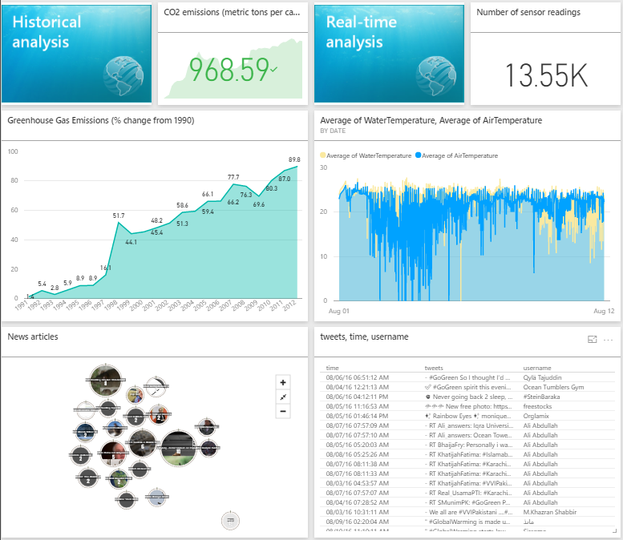

Power BI Overview
Power BI
Data sources
Power BI Service
Cloud-based SaaS solutions
e.g. Marketo, Salesforce, Quickbooks, Google Analytics, …
Content packs
Natural language query
Sharing & collaboration
On-premises data
e.g. Analysis Services, SQL Server
Organizational content packs Corporate data sources or external data services
Live dashboards
Visualizations
Azure services
Azure SQL, Stream Analytics…
Reports
Excel and CSV files
Workbook data, flat files
01001
10101
Power BI Desktop files
Data from files, databases, Azure, Online Services, and other sources
Datasets
Data refresh
Notes:
Let’s walk through an overview of what Power BI is.
1. The Power BI Service, sometimes referred to as powerbi.com, is what allows you to:
Create beautiful visualizations to tell compelling data stories.
Build rich, live dashboards that turn BI into business insights.
Create reports & datasets from which you can create visualizations and dashboards.
Enjoy the benefits of up-to-date data with real-time, automatic and scheduled refreshes.
Share dashboards easily with other people in your organization.
Ask questions of data in plain English with Natural Language Query.
Stay connected to data all the time with mobile applications.
2. Power BI connects to a variety of data sources. These range across both cloud and on-premises sources, and include:
A variety of popular SaaS solutions, such as Marketo, Salesforce, GitHub, Dynamics CRM, Zendesk, and several others.
On-premises databases – Power BI offers live connectivity to SQL Server Analysis Services and others, which we’ll cover in more detail later. And using a gateway solution, Power BI can connect to other database solutions.
Custom data sources – Power BI can connect to any data source you need it to thanks to its extensibility via REST APIs. This includes both proprietary corporate data sources, as well as external data services. For example, if you are a SaaS solution provider, you can work with Microsoft to connect your solution to Power BI.
Other Azure services – Power BI integrates tightly with SQL Azure and Stream Analytics, and will be integrating closely with more Azure services over time.
Power BI Desktop, Excel and CSV files – Excel workbooks can be directly connected to Power BI.com, or may be used with Power BI Desktop. Power BI Desktop is the companion application to the Power BI service – it is a desktop tool that supports data analysis and reporting. Like Excel files, or CSV files, Power BI Desktop files can be uploaded to the Power BI service.

Slide 6
Power BI Overview
Power BI
Data sources
Power BI Service
Cloud-based SaaS solutions
e.g. Marketo, Salesforce, Quickbooks, Google Analytics, …
Content packs
Natural language query
Sharing & collaboration
On-premises data
e.g. Analysis Services, SQL Server
Organizational content packs Corporate data sources or external data services
Live dashboards
Visualizations
Azure services
Azure SQL, Stream Analytics…
Excel and CSV files
Workbook data, flat files
Reports
01001
10101
Power BI Desktop files
Data from files, databases, Azure, Online Services, and other sources
Datasets
Data refresh
Power BI Desktop
Power BI Platform
Prepare
Explore
Report
Share
</>
embed, extend, integrate
Notes:
There is more….
3. Power BI Desktop is a visual data exploration tool that enables you to analyze data and create stunning reports. With Power BI Desktop, you are able to:
Acquire and prepare data using extensive query capabilities.
Manipulation and consolidation of multiple data sources is performed in Power BI Desktop – this enables Power BI service users to use data from multiple sources in a single report.
Establish data structure, then transform and analyze data.
Visualize and explore your data in new ways through a freeform drag-and-drop canvas.
Author reports with a broad range of modern data visualizations.
Publish beautiful, interactive reports directly to powerbi.com.
Securely share reports through unique, curated content library approach.
4. Finally, the Power BI Platform allows you to embed, extend, and integrate Power BI into other applications and environments.

Slide 7
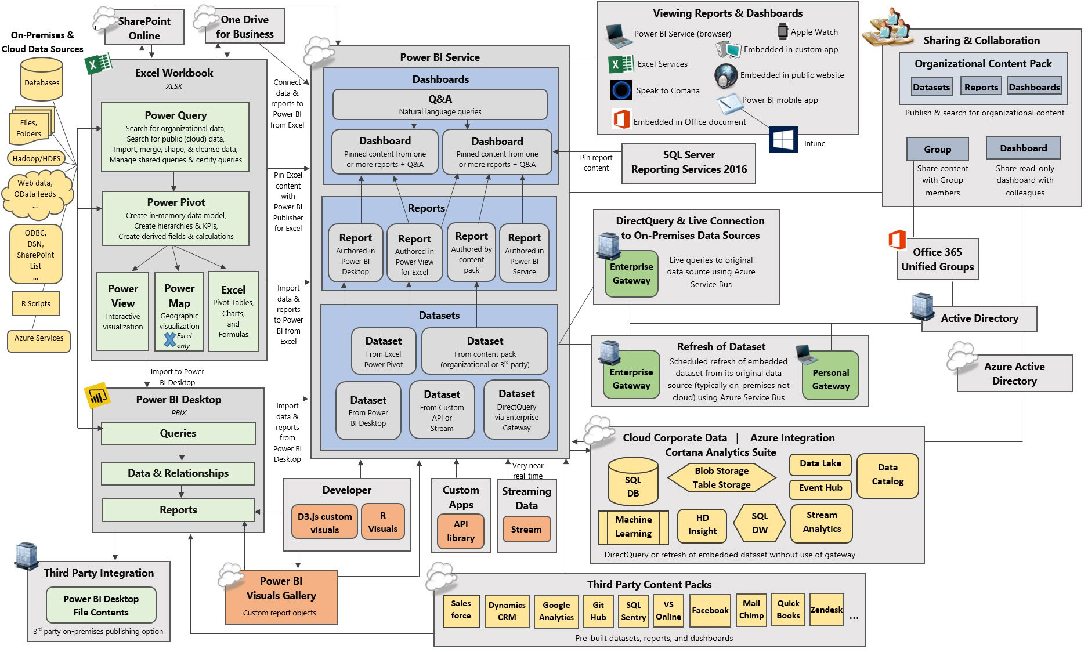

Slide 8
Power BI Licensing

Slide 9
Power BI Licensing
Power BI Pro
Power BI Premium Per User (PPU)
Licensed by users.
Quick, easy-to-use self-service analytics for users requiring collaboration, dashboard sharing, ad hoc analysis, and report publishing.
Mac users can author Power BI content in the web browser. There is no version available for Mac.
Licensed by users.
GA on April, 2, 2021 at a price of $20 per user, per month.
Get Automated machine learning (AutoML), Cognitive Service, and Deployment pipelines capabilities.
Support for Pixel perfect paginated reports
User-based
Power BI Premium
Power BI Embedded
Capacity-based
Licensed by consumption/capacity.
An add-on to Power BI Pro for projects requiring heightened performance and the ability to publish reports and dashboards to consumers.
Acquire more features like Power BI Deployment Pipeline (BIOps), Auto ML capabilities etc.
Plan the sizing using calculator here.
Power BI Premium subscriptions are purchased by administrators in the Microsoft 365 admin center.
Licensed by consumption/capacity.
An ISV & developer offering for adding analytics & visuals into applications built & distributed without requiring per user licensing.
Requires one Power BI Pro license for authentication.
Remark: the content is last updated as of Dec 2020
Notes:
The EPM that nominates the engagement for Azure Migration Assistance gathers info and completes a one-pager for the engagement such as the one found here.
The Account team raises a request via Unified Action Tracker (UAT) and assigns to a distribution list for Azure Migration Assistance.
Decision needed: who should be on the distro list?
Once the UAT ticket has been created and assigned to the distro, the people on the distro will see an email notification. I will primarily be responsible for monitoring the UAT issues coming in along with any help from Lone as a backup if needed.
We then tag each request with Azure Migration Assistance so we can easily separate these from other Scrum requests.
Decision needed: confirm we should use Azure Migration Assistance as the tag.
The request can then be reassigned to the owner that will be assigned to help unblock based on decision in this forum.
A view in MSXi Dashboard can be created based on the tag which we can use to review the status or send email status updates using this view.

Slide 10
Power BI Premium pricing
Node
Virtual cores¹
Deployment option
Price per month²
Power BI Premium EM1³
1
PaaS
$625
Power BI Premium EM2³
2
PaaS
$1,245
Power BI Premium EM3³
4
PaaS
$2,495
Power BI Premium P1
8
SaaS or PaaS
$4,995
Power BI Premium P2
16
SaaS or PaaS
$9,995
Power BI Premium P3
32
SaaS or PaaS
$19,995
Power BI Premium P4
64
SaaS or PaaS
$39,995
Power BI Premium P5
128
SaaS or PaaS
$79,995
¹ Can use virtual core pooling to allocate capacities. See this for more information
² Yearly commitment. EM3-P1 also available with monthly commitment via Web Direct ³ EM1, EM2, EM3 SKUs do not include Power BI Report Server
All pricing subject to change, please consult price list for actual pricing

Slide 11
Power BI Tooling
Remark: the content is last updated as of Dec 2020
Power BI Desktop
Dax Studio
SSMS
Licensed by users.
Free to use; however, sharing reports and publishing to cloud require Power BI Pro subscription.
Quick, easy-to-use self-service analytics for users requiring collaboration, dashboard sharing, ad hoc analysis, and report publishing.
Use in tandem with Power BI Service (cloud-based hosting)
Licensed by users.
Free to use.
A client tool for executing DAX queries against various data sources.
DAX Studio will scan the local machine for any running instances of Power BI Desktop or SSDT Integrated Workspaces.
Licensed by users.
Free to use.
An integrated environment for managing any SQL infrastructure, from SQL Server to Azure SQL Database.
Tools to configure, monitor, and administer instances of SQL Server and databases.
Power BI Desktop for Report Server
Power BI Report Builder
SSDT
Licensed by users.
Free to use.
Quick, easy-to-use self-service analytics for users requiring collaboration, dashboard sharing, ad hoc analysis, and report publishing.
Use in tandem with Power BI Report Server (on-premise hosting)
Licensed by users.
Free to use.
A tool for authoring paginated reports.
Use in tandem with Power BI Service or Power BI Report Server.
Licensed by users.
Free to use.
A modern development tool for building SQL Server relational databases, Azure SQL Databases, Analysis Services (AS) data models, Integration Services (IS) packages, and Reporting Services (RS) reports.
Notes:
The EPM that nominates the engagement for Azure Migration Assistance gathers info and completes a one-pager for the engagement such as the one found here.
The Account team raises a request via Unified Action Tracker (UAT) and assigns to a distribution list for Azure Migration Assistance.
Decision needed: who should be on the distro list?
Once the UAT ticket has been created and assigned to the distro, the people on the distro will see an email notification. I will primarily be responsible for monitoring the UAT issues coming in along with any help from Lone as a backup if needed.
We then tag each request with Azure Migration Assistance so we can easily separate these from other Scrum requests.
Decision needed: confirm we should use Azure Migration Assistance as the tag.
The request can then be reassigned to the owner that will be assigned to help unblock based on decision in this forum.
A view in MSXi Dashboard can be created based on the tag which we can use to review the status or send email status updates using this view.

Slide 12



Power BI Report Hosting Options
SQL Server Reporting Services
Power BI Report Server
Power BI Service
Power BI Embedded
Deployment
On-premises
On-premises
Cloud
Cloud
Power BI reports
Real-time dashboards
Content packs
Q&A
Quick Insight
Paginated reports
Mobile reports
Lifecycle
Fixed lifestyle policy
Modern lifestyle policy
Fully managed service
APIs
Remark: the content is last updated as of Dec 2020
Notes:
Details on mobile BI (SSRS Datazen still supported etc.)
Discussion of features of Power BI Service that aren’t available in Power BI Report Server
Modern and Fixed policies
https://support.microsoft.com/en-us/help/4014109/announcing-modern-and-fixed-policies

Slide 13
Example of Power BI Licensing Scenario (TBA)

Slide 14
Why Power BI?

Slide 15
IT challenges
Faster time to solution and ease of management
Management of BI systems
Power BI is a Software as a Service (SaaS) BI solution
No need to setup your own hardware
99.9% uptime SLA
Grows with your needs for number of users and data volumes
Ease of maintenance with automatic updates
Realize the benefits of a SaaS-based BI solution without moving your data to the cloud
More time to focus on business needs and creating better solutions for end users
Power BI will meet your security and compliance requirements
Use Azure Conditional Access policies for secure access
Manage users, groups, admins (in O365 admin portal)
View and search audit logs (in O365 Security and Compliance portal)
View usage metrics
Specify tenant settings – what features are available in your organization
Variety of data sources
Managing data in the cloud
Integration with existing environment
Keeping data current
Ease of use and adoption
Notes:
Key message:
Power BI is a Software as a Service (SaaS) BI solution
Talking points: Power BI enables fast deployment with guaranteed SLAs for uptime
Power BI scales to your demands, without having to worry about new hardware acquisitions and maintenance
The service is updated for you
Tenant management and usage logs for Power BI for your company is done through the Power BI admin portal.
Security and auditing are managed in the Office 365 Admin Portal. Access to the O365 admin portal can be secured with the Power BI Admin role.
Power BI supports Azure AD Conditional Access to provide more control for how users access Power BI.
Power BI Auditing allows administrators to monitor important user activities.

Slide 16
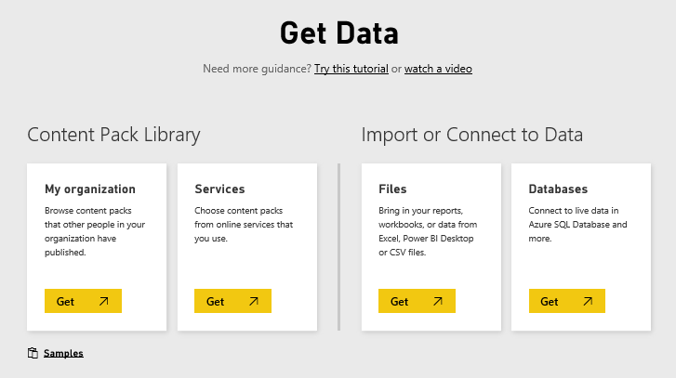
IT challenges
Built-in connectivity to all of your data
Management of BI systems
Lowered IT investment in ETL infrastructure
Data from services
Content packs for SaaS services that you already use
Growing number of supported SaaS solutions
Data from databases
Cloud: Azure SQL Database, Azure SQL Data Warehouse, Spark on HDInsight
On-premise: SQL Server Analysis Services tabular or multi-dimensional, SQL Server, SAP HANA, Oracle, Teradata (Gateway required)
Data from your organization
Content published by others in your org
Data from files
Import data from Excel, Power BI Desktop, or CSV files
Connect (upload), manage and view Excel in Power BI
Solution templates
Quickly provision end-to-end, enterprise solutions
Variety of data sources
Managing data in the cloud
Integration with existing environment
Keeping data current
Ease of use and adoption
Notes:
Key message:
Power BI connects to a variety of data sources, enabling you to view and explore data from hybrid sources in a single location.
Talking points:
The Power BI Get Data feature lets you quickly and easily connect to all of your data
This includes a range of both cloud sources, on premises sources and specific data files —from the SaaS solutions you already use to your organization’s on-premises data
Many sources have been integrated with Power BI, connecting in minutes with pre-built dashboards and reports
For the first time, you can easily get a consolidated view of your data, no matter where the data actually lives
Data from files
Solution templates: you don’t need to start from scratch. Start with a working end-to-end enterprise-ready Power BI solution that incorporates top technical and business practices

Slide 17
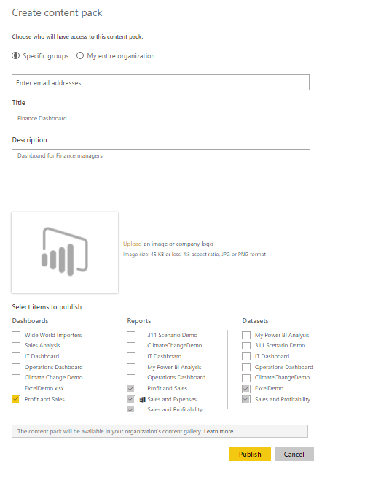
IT challenges
Create organizational content packs
Management of BI systems
IT can work with the business analysts to create content packs for an organization
Content packs include
pre-built dashboards
reports
pre-defined data models
IT can focus on providing authoritative datasets to analysts and end users, instead of developing reports
Sample content packs for industry related scenarios are provided
Variety of data sources
Global Sales
Managing data in the cloud
Integration with existing environment
Keeping data current
Ease of use and adoption
Notes:
Key message:
With Power BI you can create organizational content packs for your organization
Talking points:
If you need to make data available across your organization, a custom connector can do just that in an efficient way. For example, your finance team can provide access to financial data to the appropriate users across the organization.
Create content packs which make it easier and faster for users to explore the data you’re providing – they get dashboards and reports that they can use immediately to drive insights

Slide 18
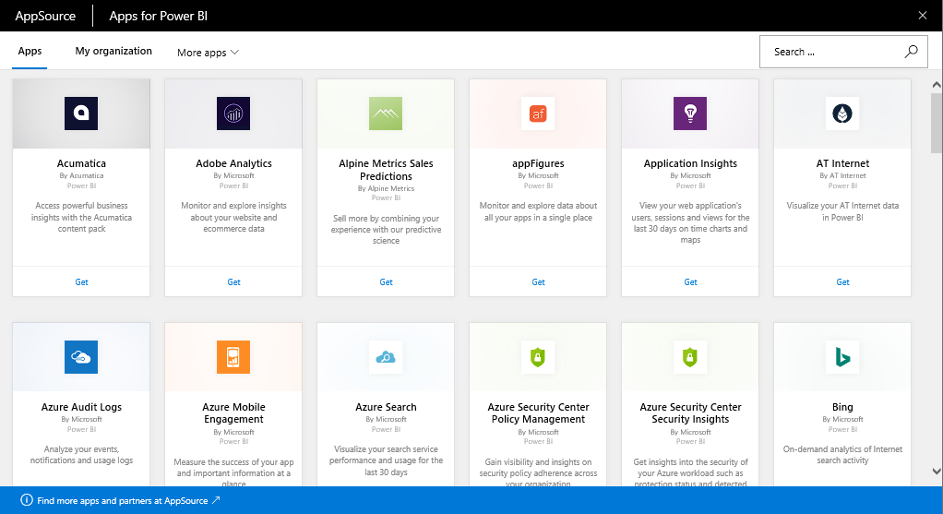
IT challenges
Get instant value from your cloud data sources
Management of BI systems
No need to build connectors or develop data extraction processes for your SaaS solutions
Business can quickly start with solution-specific content packs which include
pre-configured dashboards
reports
data models
Users can explore data with fast data processing
Automatic data refresh is built-in
Variety of data sources
Managing data in the cloud
Integration with existing environment
Keeping data current
Ease of use and adoption
Please refer to powerbi.com for latest list of SaaS partners
Notes:
Key message:
Power BI comes with content packs for the SaaS solutions that you already use
Talking points:
It’s easy to discover business insights quickly by connecting all of the SaaS data sources you already use to Power BI
Power BI has “connector” functionality that establishes a direct connection to a variety of popular SaaS solutions
It’s more than just a connection though – Power BI has a “content pack” for each SaaS solution
These “content packs” consist of pre-configured dashboards, reports, data models, embedded queries and metadata
That means users don’t have to set anything up from scratch – you connect your data and instantly have a beautiful dashboard ready for you to customize to your needs
Thanks to the direct connection from Power BI, data processing is optimized, so you can explore at a rapid pace
And data is updated automatically each day (or on-demand if you need it) – no need for special refresh configuration

Slide 19







IT challenges
Consume structured/unstructured data using other Azure services
Management of BI systems
Connect directly to data from Azure services, including
Azure SQL Database
Azure SQL Data Warehouse
Spark on HDInsight
Push live, streaming data from Azure Stream Analytics with built-in destination for Power BI for real-time dashboards at any scale
Integration with other Azure services, including Azure ML, opens up new scenarios, without writing thousands of lines of code
Variety of data sources
Stream Analytics
Event Hubs
Managing data in the cloud
Machine Learning
Integration with existing environment
Power BI
Storage
Keeping data current
SQL Server
HDInsight
Ease of use and adoption
Notes:
Key message:
Power BI works directly and seamlessly with other Azure Data Services
Talking points:
For example, Power BI integrates with SQL Database and SQL Data Warehouse, making it easier to query large data sets in real-time
Power BI also directly integrates with Azure Stream Analytics - real-time data from Stream Analytics can be pushed directly into Power BI for real-time visibility via dashboards
For example, if you have IoT devices like sensors and factory-floor machines connected to Stream Analytics, that data can be surfaced live to Power BI dashboards, so operations managers can get real-time information on the status of plant operations

Slide 20
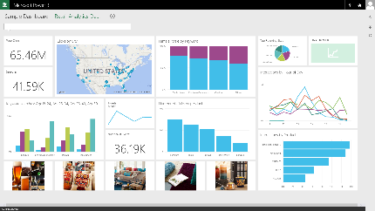
IT challenges
Live connectivity to your on-premises data
Management of BI systems
Connect live to your existing on-premises data sources:
Analysis Services (tabular and multidimensional)
SQL Server
SAP HANA
Oracle
Teradata
Requires On-Premises Data Gateway
Role-based and row-level data security
Data remains on-premise, only query is stored in Power BI
Live Power BI Dashboards and Reports
PowerApps
Variety of data sources
Microsoft Flow
Azure Logic Apps
Managing data in the cloud
Scheduled Refresh
Manage & Monitor
Cloud
Integration with existing environment
On-premises
On-Premises Data Gateway
Data Source
Data Source
Keeping data current
Ease of use and adoption
Notes:
Key message:
Connect live to your existing on-premises data, such as SQL Server Analysis Services. No need to move your data to the cloud
Talking points:
Power BI lets you establish live connectivity with on-premises SQL Server Analysis Services tabular and multi-dimensional models
Use On-Premises Data Gateway to configure the connection with your existing SSAS solution (replaces the Analysis Services Connector).
The connection is live – meaning that when users view and explore dashboards, Power BI interactively queries the on-premises cube to fetch the data right then
This enables efficient data exploration thanks to optimized query performance
You can create reports with SSAS data on powerbi.com, even while data remains on-premises
Your existing, role-based SSAS permissions still apply – user access to SSAS data via Power BI is controlled the same way
The connection to SSAS is secured via Azure Service Bus SSL encryption

Slide 21

IT challenges
Connect to data from your files
Management of BI systems
Import data into Power BI from files
Microsoft Excel (xlxs or xlsm)
Power BI Desktop (pbix)
Comma Separated Value (csv)
Files can be located on
Local machine
OneDrive Business or Personal
SharePoint Team Sites
Two ways to use Excel files
Import into Power BI
Connect (upload), manage and view in Power BI
Any changes to a file in OneDrive or SharePoint are synced automatically (hourly)
Data and reports from Power BI Desktop files
Variety of data sources
Managing data in the cloud
Integration with existing environment
Keeping data current
Ease of use and adoption
Notes:
Key message:
You can upload Excel, CSV and Power BI Desktop files from your computer, or connect to them on OneDrive for Business, OneDrive Personal or SharePoint Team Sites
Talking points:
Where your file is saved makes a difference
Local - If you save your file to a local drive on your computer or another location in your organization, from Power BI, you can import your file into Power BI. Your file will actually remain on your local drive, so the whole file isn’t really imported into Power BI. What really happens is a new dataset is created in your Power BI site and data, and in some cases the data model, are loaded into the dataset. If your file has any reports, those will appear in your Power BI site under Reports.
OneDrive - Business – If you have OneDrive for Business and you sign into it with the same account you sign into Power BI with, this is by-far the most effective way to keep your work in Excel Power BI Desktop, or a .CSV file and your dataset, reports, and dashboards in Power BI in-sync. Because both Power BI and OneDrive are in the cloud, Power BI connects to your file on OneDrive about every hour. If any changes are found, your dataset, reports, and dashboards are automatically updated in Power BI.
OneDrive - Personal – If you save your files to your own OneDrive account, you’ll get many of the same benefits as you would with OneDrive for Business. The biggest difference is when you first connect to your file (using Get Data > Files > OneDrive – Personal) you’ll need to sign in to your OneDrive with your Microsoft account, which is usually different from what you use to sign in to Power BI. When signing in with your OneDrive with your Microsoft account, be sure to select the Keep me signed in option. This way, Power BI will be able to connect to your file about every hour and make sure your dataset in Power BI is in-sync.
SharePoint Team-Sites – Saving your Power BI Desktop files to SharePoint – Team Sites is much the same as saving to OneDrive for Business. The biggest difference is how you connect to the file from Power BI. You can specify a URL or connect to the root folder.
Get data and reports from Power BI Desktop files.

Slide 22
IT challenges
Keep your data where it is and connect securely
Management of BI systems
Faster time to insight with a hybrid BI solution
Cloud data sources
SaaS sources
Azure – SQL, DW, Blob, Table, HDInsight, Marketplace
SharePoint, web sources
OData (SAP HANA)
OneDrive
On-premise data sources
SQL Server, Teradata, Oracle, DB2, MySQL, PostgreSQL, Sybase, SAP HANA, Access, Custom SQL, Custom ODBC Drivers
SQL Server Analysis Services (tabular and multi-dimensional)
Files/folder, SharePoint on-premises
Live Power BI Dashboards and Reports
Variety of data sources
SaaS, Azure, SharePoint, Web, OneDrive
Managing data in the cloud
Cloud
Integration with existing environment
On-premises
SQL Server Analysis Services
Data Source
Data Source
Keeping data current
Ease of use and adoption
Notes:
Key message:
You can keep your data where it is
Talking points:
﻿﻿﻿﻿﻿﻿Power BI connects to data sources on your behalf. The connections require valid accounts that meet the requirements of the specific data source.
In order for Power BI to refresh your dataset, you will need to provide credentials for that particular data source. The type of credentials required depend on the data source your dataset is connecting to. You will be required to enter credentials the first time you use Schedule Refresh or Refresh Now. Once entered, those credentials will be retained as part of refresh settings for that dataset. If you get data from another workbook that uses the same data source in a dataset you've already configured authentication credentials for, you won't need to configure credentials again for your new dataset﻿﻿.

Slide 23
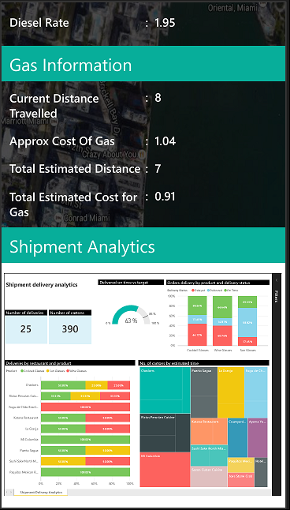
IT challenges
Embed, extend, and integrate with the Power BI Platform
Management of BI systems
Application developers can embed Power BI tiles and reports as an IFrame into an app, such as a mobile app or web app.
Use the REST API to push data directly from your application into Power BI
Programmatically access Power BI resources (datasets, tables, schemas)
Secure access to Power BI service using Azure Active Directory and OAuth 2.0 authentication
Create your own custom visuals from the published open source visuals and the provided framework
Variety of data sources
AAD User
Managing data in the cloud
Integration with existing environment
Keeping data current
Anonymous
Ease of use and adoption
Notes:
Key message:
Power BI provides developers with a platform to embed, extend and integrate Power BI into other applications
Talking points:
Embed
Power BI reports and tiles can be embedded into existing applications.
Extend
You can create a custom visual using the Power BI Developer Tools (Preview). In the Power BI Developer Tools, design and test a custom visual by writing custom visual TypeScript code, and creating CSS. Once you've tested your custom visual, you can export it to Power BI, or submit it to the Power BI visuals gallery.
Integrate
Here are some of the important uses of APIs:
Push data directly from another application into Power BI
Push not only static data, but also real-time data, into Power BI
Just as Azure Stream Analytics can push data directly into Power BI, you can enable other applications to do the same thing for real time visibility
This enables users to manage and monitor real-time content
As discussed earlier, you can create custom connectors and content packs for unique data sources that Power BI doesn’t support as a default
Manage authentication using Azure Active Directory integration

Slide 24
IT challenges
Keep your data current
Management of BI systems
Access and refresh the data via
Direct Query (Azure SQL, DW and Spark HDInsight)
Import (with scheduled refresh)
REST APIs to stream data
Refresh on-premise data with
Power BI Personal Gateway
On-Premises Data Gateway
Live Power BI Dashboards and Reports
Variety of data sources
SaaS, Azure, SAP, Web, Oracle, Salesforce.com
Managing data in the cloud
Live Query
Direct Query
Scheduled Refresh
Cloud
Integration with existing environment
On-premises
SQL Server Analysis Services
Data Source
Data Source
Keeping data current
Ease of use and adoption
Notes:
Key message:
Power BI makes it possible to keep all your data current – and visualizations automatically recalibrate when data changes
Talking points:
Refresh your Azure SQL Server, Azure SQL Data Warehouse, Spark on HDInsight data using DirectQuery. With DirectQuery, queries are sent back to your Azure data store in real time as you explore the data. This, combined with the scale of Azure enables users to create dynamic reports in minutes against terabytes of data.
With SaaS solutions, data is refreshed automatically, typically on a daily basis
Data may also be refreshed on demand
And even without user intervention, data is queried every 10 minutes to keep the dashboard up-to-date
Use live connectivity to SQL Server Analysis Services (SSAS) to see updates in your Power BI dashboard/report as the user interacts with it
Get real-time visibility via integration with Azure Stream Analytics, or by pushing data into Power BI using REST APIs
With the Power BI Gateway, you can schedule refreshes for your on-premises databases
Row level security: Re-use on-prem role based row level security for Analysis Services

Slide 25
IT challenges
Scheduled refresh with Power BI Personal Gateway
Management of BI systems
Personal Gateway empowers the business analyst to securely and easily refresh on-premise data
Self-service data refresh - no help from IT required
Easy & simple to use - lightweight one-click installer
One Personal Gateway per user
Runs either as a service or an app
Import of data with scheduled refresh
Live Power BI Dashboards and Reports
Variety of data sources
Managing data in the cloud
Scheduled Refresh
Installed locally
Cloud
Integration with existing environment
Personal Gateway
On-premises
Data Source
Data Source
Data Source
Keeping data current
Ease of use and adoption
Notes:
Key message:
Personal Gateway is required to refresh datasets from a supported on-premised data source in your organization.
Talking points:
Personal Gateway is available with Power BI Pro.
Anyone can refresh With Personal gateway, everyone can keep their data in Power BI in sync with their on-premises sources. No IT Dependency
Easy & simple to use Personal Gateway is a lightweight one-click installer and once it is up and running on your computer, data refresh is seamless
The Gateway supports REFRESH NOW and a SCHEDULE REFRESH. The data is cached
Data transfer is secure. Data transfer between Power BI and the gateway is secured through Azure Service Bus. The Service Bus creates a secure channel between the Power BI service and your computer. Because the gateway provides this secure connection, there’s usually no need to open a port in your firewall.

Slide 26
IT challenges
Centralized data refresh with On-Premises Data Gateway
Management of BI systems
IT departments can deploy and manage on-premise data access centrally
BI governance: IT can monitor and audit usage
Live, interactive query to on-premises data sources (e.g. SQL Server) and scheduled refresh
One gateway for multiple cloud services and experiences: Power BI, PowerApps, Microsoft Flow, Azure Logic Apps
Gateway recovery and restore features built-in
PowerApps
Variety of data sources
Live Power BI Dashboards and Reports
Microsoft Flow
Azure Logic Apps
Managing data in the cloud
Scheduled Refresh
Manage & Monitor
Cloud
On-Premises Data Gateway
On-premises
Integration with existing environment
Data Source
Data Source
Data Source
Keeping data current
Ease of use and adoption
Notes:
Key message:
Enables IT departments to centrally deploy and manage on-premise data access, for a large group of users.
Talking points:
Centralized way to refresh content in Power BI
Configure, manage and maintain a group of On-Premises Data Gateways. Transparently refresh data uploaded to Power BI for the business users and analysts.
Centralized access control
Centrally manage the set of users who can access the underlying data sources. Assign user permissions.
Enables BI governance – empower IT to monitor and audit usage
Gain visibility into Data Gateway usage, such as commonly accessed data sources, and the users accessing them.
Direct access
Direct access to a wide range of data sources, like SQL Server, SQL Server Analysis Services.
Secure data transfer
Data transfer between the Power BI service and the gateway is secured through Azure Service Bus. The Service Bus creates a secure channel between the Power BI service and your computer. Because the gateway starts this secure connection, there’s usually no need to open a port in your firewall because it is an outbound connection.
Works with multiple services: Power BI, PowerApps, Microsoft Flow, Azure Logic Apps
Disaster recovery and gateway restore: Gateway admin can use the recovery key to restore a gateway to a different machine. Once a gateway is restored, all data sources and credentials will continue to work through the new gateway. Restored gateway will have the same name, so no need for re-publish.

Slide 27
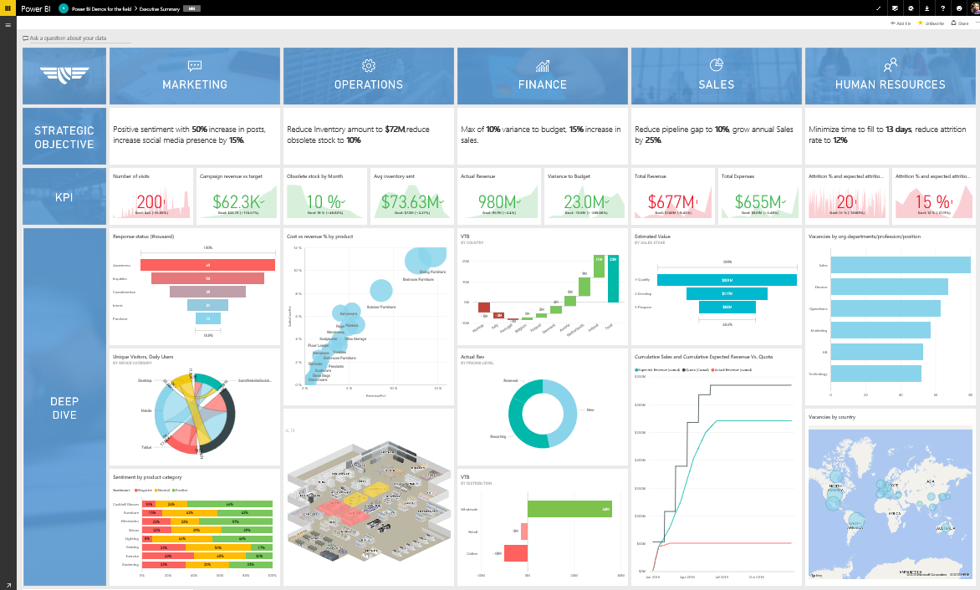
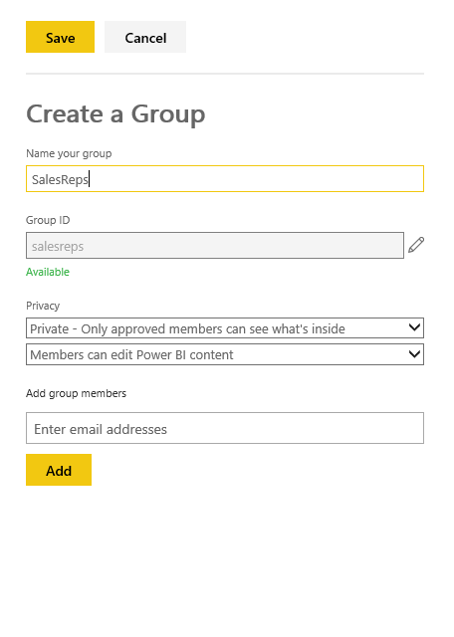
IT challenges
Easy to use and drive adoption
Management of BI systems
Easy to use
For end users: intuitive and interactive dashboards and reports
For BI analysts: familiar tools to create data models and reports
For IT: Administering Power BI tenants, users, and groups is the same as in Office 365
Easy to share
End users can easily share dashboards and reports, inside and outside the organization
Collaborate with others in a group workspace
Create content packs and publish them to your organization
Variety of data sources
Managing data in the cloud
Integration with existing environment
Keeping data current
Ease of use and adoption
Notes:
Key message:
Power BI helps your organization to drive user adoption with intuitive and familiar tools and collaboration features
Talking points:
For IT: administering Power BI tenants, users, and groups is the same as administering them in Office 365
For the analyst: familiar tools for data preparation, modeling, and report creation – Power BI Desktop and Excel
For the end user:
Share a dashboard with colleagues and others
When you share a dashboard, those you share it with can view it and interact with it, but can't edit it. They can see the same data that you see in the dashboard and reports. Your colleagues can share the dashboard with other colleagues, if you allow them to. Those outside your organization can view and interact with the dashboard, but can't share it..
Make changes to dashboard after you’ve sent it out, and it will automatically sync across all users
Share only your dashboard, keeping access to the source data and reports secure. What this means: Users who receiving a sharing invitation cannot change filters or drill down into data - they only see what’s in the dashboard
Manage who can re-share dashboards with others
Share dashboards based on email or O365 distribution group
Share without email notification, copy and share a link instead, e.g. on another portal
People picker with autocomplete as you start typing the name of recipients
Copy/paste large number of email addresses you want to share with, e.g. copy directly from Outlook
Collapse navigation pane with URL parameter
Collaborate in a group workspace
Groups in Power BI are built on Office 365 groups, so you and your colleagues need a Power BI Pro license. When you're a member of a group, you can create a dashboard in the group workspace. Everyone in the group can view, interact with, and edit the dashboard and its reports. They have the same permission you have
Create a content pack and publish it
Content packs are a great way to share your Power BI insights with your colleagues.
You create a dashboard with its reports and datasets, and then publish them all together as a content pack -- either for your whole organization or for those in a specific security group or distribution list. When those colleagues go to the Content Pack Library for their organization, they see your content pack along with any others they have permission to see

